Slide 1
Flipping Your Algebra and Statistics Classrooms georgewoodbury.com/AMATYC2017
George Woodbury
(Session S148)

Slide 2
Quiz
Do your students come to class prepared for that day’s work?
Do you want your classroom to be an active space for rich and engaging learning?

Slide 3

Flipped Learning is for You!
Source: vivendoavidabemfeliz.blogspot.com

Slide 4

Misconceptions About Flipped Learning

Slide 5
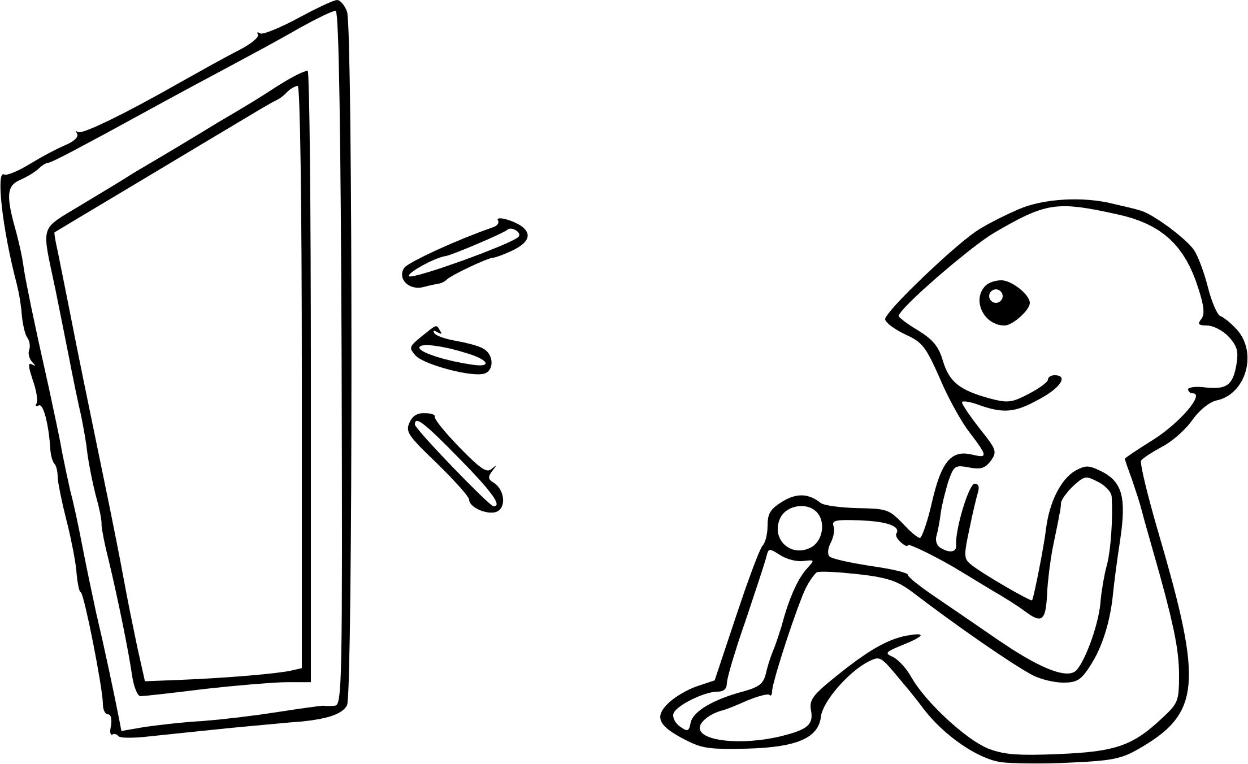
Misconceptions About Flipped Learning

Slide 6
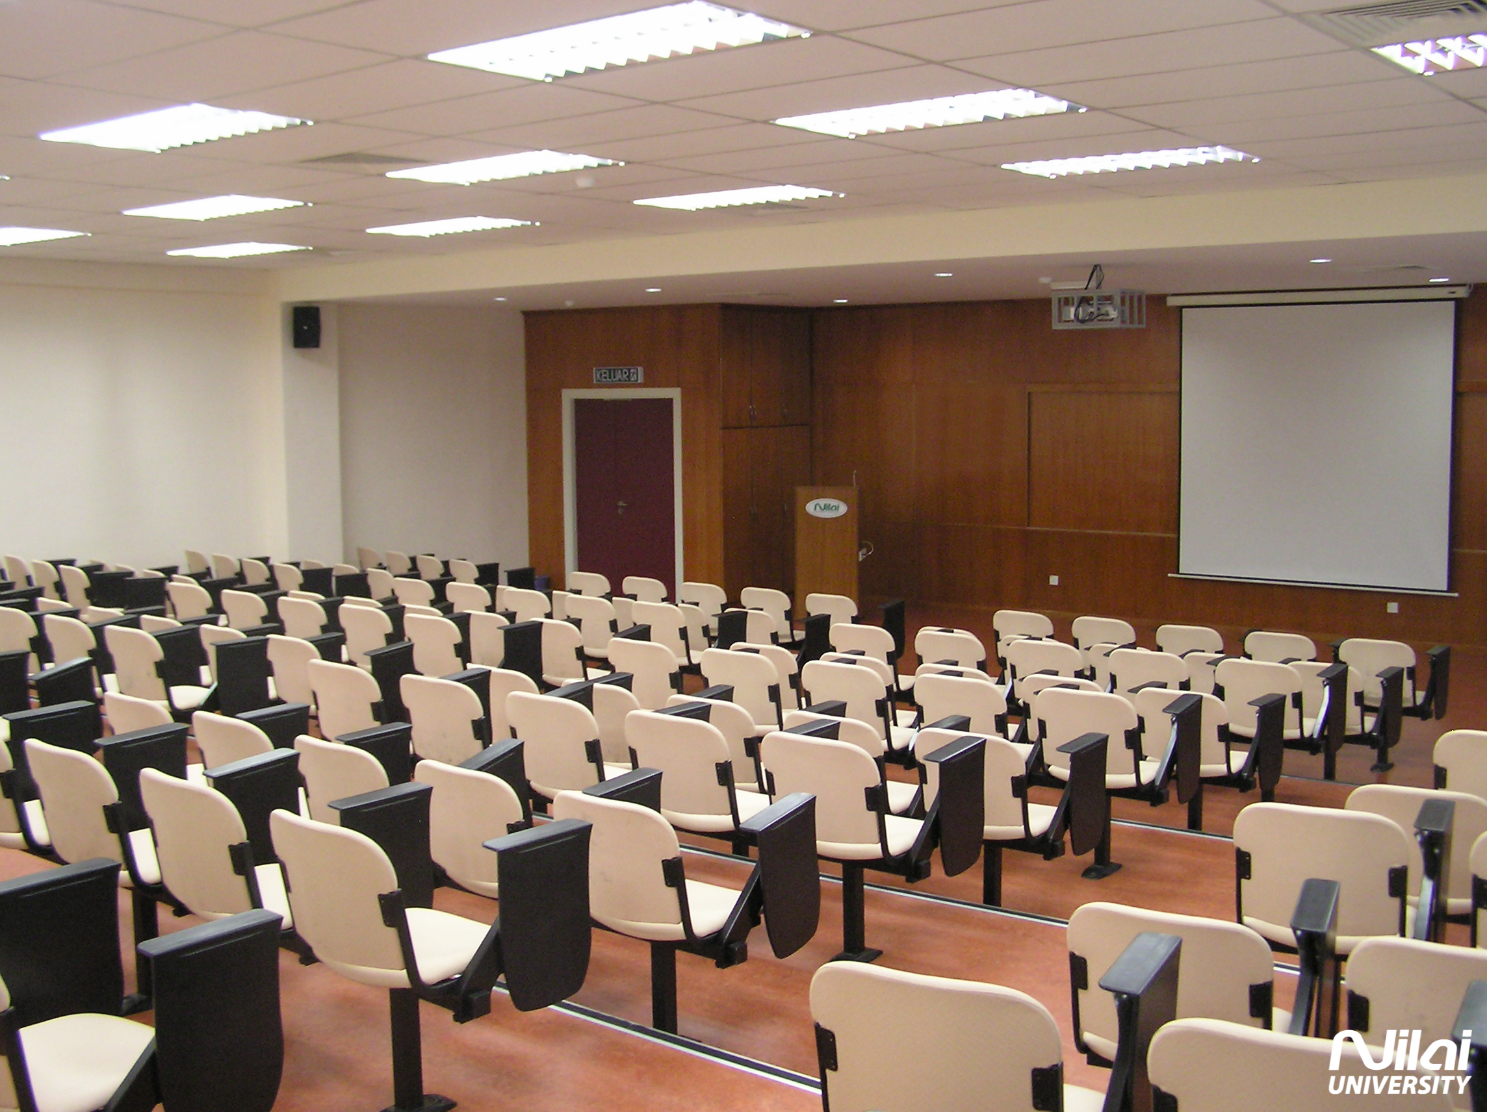
What IS Flipped Learning?
Source: Eduspiral.com

Slide 7

What IS Flipped Learning?
Source: geigerslhs.wikispaces.com

Slide 8
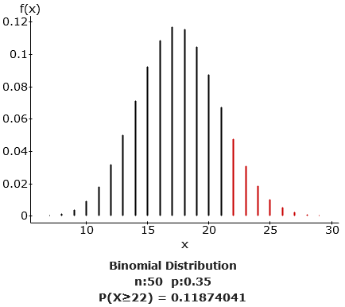
How I Did It – Introductory Statistics

Slide 9
How I Did It – Introductory Statistics
Pre-Class
Students complete an Interactive Reading Assignment before class.
These assignments are a mixture of text, video, and problems.

Slide 10
How I Did It – Introductory Statistics
In-Class
Use a Student Response System (SRS) for Peer Instruction.
Use Immediate Feedback Assessment Technique (IF-AT).
Give collaborative assignments that go over the material covered before class as well as extend knowledge to new tasks.
Use projects that require students to use data they collected to build upon their previous knowledge.

Slide 11
How I Did It – Introductory Statistics
Post-Class
Students complete a short, “standard” homework assignment based on the section we worked on.
Some assignments are turned in online and others are turned in by hand.

Slide 12
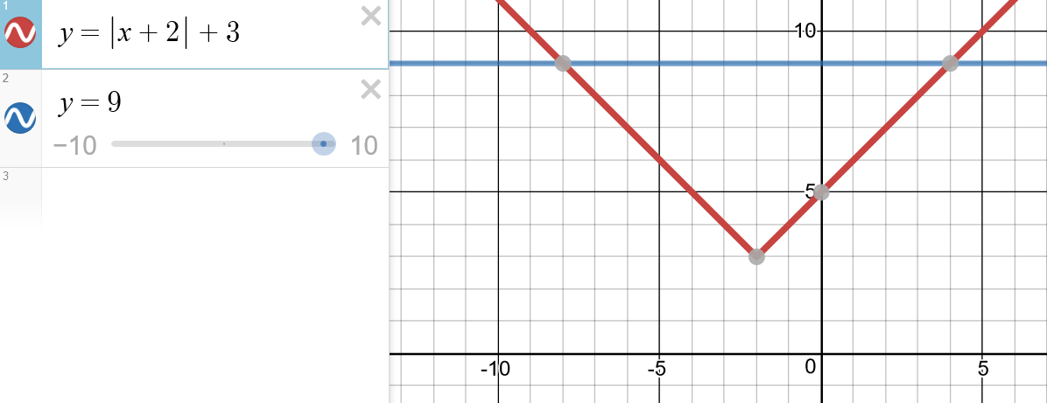
How I Did It – Elementary & Intermediate Algebra

Slide 13
How I Did It – Elementary & Intermediate Algebra
Pre-Class
Students complete an assignment before class.
Mixture of conceptual videos, example videos, and problems.

Slide 14
How I Did It – Elementary & Intermediate Algebra
In-Class
Give group assignments that go over material from pre-class assignment.
Use interactive mini-lectures to introduce new topics.
Give group assignments to solidify/extend understanding of new topics.

Slide 15
How I Did It – Elementary & Intermediate Algebra
Post-Class
Students take a short (5-question) quiz.
The quiz loads a personalized homework assignment based on problems from the quiz that require more practice.
After completing the personalized homework assignment, students can retake the quiz.

Slide 16
How I Did It – Online Algebra
I now use the same 3 assignment cycle (FLIP Assignment, Reflect Quiz, Personalized Homework) for each section covered in my online algebra classes.

Slide 17
Your Turn
Form a group and pick a topic to flip from a course that you all teach.
List the objectives for that topic, listing them from most accessible/least complex to least accessible/most complex.
Draw a line between the direct instruction that will be handled outside of class and the material where students need your guidance.

Slide 18

Recommendations for You
Source: Conrad Bakker (Flickr)

Slide 19

Recommendations for You
Source: Mozilla

Slide 20

Recommendations for You
Source: Socialbrite

Slide 21
Recommended Reading/Viewing
Flipped Learning: A Guide for Higher Education Faculty by Robert Talbert
Teaching with Classroom Response Systems by Derek Bruff
Peer Instruction Videos (YouTube) by Eric Mazur

Slide 22

Source: jaime-dulceguerrero.com

Slide 23
Read All About It!
Presentation & Summary: georgewoodbury.com/AMATYC2017
Blog: georgewoodbury.com/statblog/
Flip Site: georgewoodbury.com/flip/

Slide 24
Contact Information
Email: georgew@cos.edu
Twitter: @georgewoodbury
Website: georgewoodbury.com

